Slide 1
LIC Solution®
May 2017
Notes:
Use this slide layout as a title slide only (alternatively to EY Panel or EY Better Question Frame). We use primarily EY Panel or EY Better Question Frame title layouts.
You may replace the photo in this divider slide. You can only use black and white photography, not color. When choosing an image, follow the principles on The Branding Zone.
To change the image: Select the View tab then choose the Slide Master containing the layout you want to edit. Select the angled box and right-click on it to bring up the menu. Select Format Picture. Under Fill select Picture or texture fill. Click Insert from>File. Navigate to where you have saved the image and insert it.

Slide 2
LIC Solution®
The LIC Solution® is an automated IT solution for the calculation of impairment losses on a portfolio (collective) basis and individual basis under IFRS 9 Financial instruments standard ('IFRS 9' or 'Standard')
The IAS 39 version of LIC Solution® has been implemented in 15 institutions in CEE. We have also helped a number of European institutions during projects focusing on loan impairment reviews, IFRS methodology and back-testing
Highlights
Mid-size Slovak bank
Deployment of LIC Solution® Successful implementation of LIC Solution® in 15 banks in Central and Southeast Europe Ongoing post-implementation support services
Loan impairment review Loan impairment methodology and calculation review for a major European banking group in 8 countries across the region Review and methodology setup in major banks in 14 countries across Central and Southeast Europe Regular loan impairment review for statutory audit purposes at major banks operating in Central Europe
Fair value and other IFRS topics Delivery of fair value methodology in Central European banks Delivery of a fair value module in a major Romanian bank Unwinding of interest methodology and calculation engine deployed in several financial institutions
Back-testing of loan provisions Delivery of a back-testing methodology and a back-testing module in several Central and South European banks Performing back-testing analysis in major Slovak, Romanian and Moldavian banks
Medium-size retail Czech bank
Slovak subsidiary of a large international bank
Czech subsidiary of a large international bank
TOP 5 Slovak bank
Leading Moldavian bank
TOP 3 Romanian bank
Regional Romanian bank
Romanian subsidiary of a large Greek bank (2)
Large Romanian retail bank
Leading Cyprus bank
Greek subsidiary of a large Cyprus bank

Slide 3
LIC Solution® key concepts
IFRS 9 compliant
It is an easy to use solution that is capable of handling all of the upcoming challenges of IFRS 9 standard including:
Portfolio staging
Lifetime PD, LGD, EAD modelling
Lifetime and 12 month ECL calculation
Scenario modelling
Flexible
LIC Solution® is flexible both in Institution’s possible inputs and during calculation phase:
Alternative structure of inputs
Calculation run configuration
Variety of operational simplifications
User-friendly
LIC Solution® provides a user-friendly environment with the ability to control and track changes made by authorized users:
Easy to use web-based interface
User role definition and audit trail
Functional accessibility based on user rights

Slide 4




Integration to the Institution’s environment – illustrative logical scheme
Data flow from source systems to LIC Solution® and back from the solution to Institution’s systems is described in the scheme below. Input data are extracted by the Institution from source systems, transformed to a standardized input form and stored in an input data area. Data export, transformation and storage in target systems is carried out by the Institution.
Interfacing systems
Input data integration layer
Output data integration layer
Institution’s target systems
CBS, DWH
GL, DWH
data migration from source systems and transformation to pre-defined format
data export to target systems
Calculation engine
data upload
data extraction
Institution’s responsibility
LIC Solution®
EY responsibility

Slide 5





Architecture
LIC Solution® operates on three tiers which ensure separation of data management functions, of application processing and of end-user presentation. Application processing includes both web server as well as reporting server services.
Three-tier architecture
Institution’s IT systems
Database tier
Application tier
Client tier
Input & output from/to:
Core systems
Data warehouse(s)
Inputs & outputs standardized
Database server
Data integration services
Performs:
All business logic
All computations
Storing all parameterizations
All data-related operations, data versioning and full historization
Web application server
Reporting server
Performs:
Presentation layer functions
GUI/ user interface, web pages and reports rendering
Processes AD authentication using LDAP
Processes user requests
Data requests to database
No application server side computations (all computations are performed by the database server)
User workstations
Mobile devices
Performs:
Web pages and report presentation for the client/end-user based on user requests
Provides user inputs to the web server and reporting server
Sends to web server the user AD identity
No client side computations

Slide 6
Technical requirements
Hardware, software and access requirements for LIC Solution® are presented below. As the solution is accessible via a web browser interface, there is no additional installation effort required for its distribution among end-users.
Hardware (optimal) | Servers | Server type | Physical server or alternatively a fully dedicated virtualized server
 |  | Operating System | Windows Server 2012 or higher, 64-bit, Standard edition (as minimum) or Datacenter edition (recommended)
 |  | Additional SW installations/licensing needed | MS SQL Server 2016, 64 bit, Enterprise edition or Standard edition, IIS web server component activated, .NET framework 4.5 or higher installed
 |  | CPU | x64 Processor with 2.0GHz or faster
 |  | Nr. of accounts processed / month | Up to 100 000 |  | Up to 500 000
 |  | Number of cores | 8 (as minimum) | 12 (as minimum)
 |  | RAM | 32 GB (as minimum), 64 GB recommended | 64 GB (as minimum), 128 GB recommended
 |  | Storage (all NTFS) - number of disks, disk size | 4 disks (redundancy, and separated), overall storage requirement 500 GB | 4 disks (redundancy, and separated), overall storage requirement 1 TB
 |  | Storage - nr., usage reason, disk size | 1. OS + SQL Server installations incl. SSRS + IIS component + Web Application, ~60 GB 2. Data files incl. Index data files, ~300 GB 3. Log files, ~70 GB 4. Temporary DB, ~70 GB | 1. OS + SQL Server installations incl. SSRS + IIS component + Web Application, ~60 GB 2. Data files incl. Index data files, ~600 GB 3. Log files, ~200 GB 4. Temporary DB, ~200 GB
 | Clients | Operating system | Windows 7 or higher
 |  | Web browser | MS Internet Explorer 11.0 or higher, Google Chrome, Mozilla Firefox
Access | Servers | Connection type | Remote access via a VPN connection upon agreement
 |  | Database server | Expected: Read only access (at least timely limited) for operational issue investigations (2nd level) and ad-hoc analyses, upon critical request; Alternatively, a depersonalized copy of the production environment onto test/investigation environment is sufficient, however time is needed to prepare such instance.
 |  | Web server, Reporting server (SSRS) | Not required

Slide 7
Calculation process flow
Data Input
Loading calculation inputs from source systems in a standardized structure. These inputs are then validated using data quality checks.
Segmentation and staging
Performing automatic selection for individual assessment and segmentation into IFRS 9 stages.
Output
Preparing standardized data extracts, built-in reports and comparison to previous runs.
03
05
01
02
04
Configuration and process control
Selecting the version of input data and configuration of calculation parameters (e.g. Staging criteria, Risk parameters) and link to previous calculation run.
ECL calculation
EAD, LGD and PD modelling. Performing impairment calculation using cash flow scenarios or portfolio risk parameters.

Slide 8
Data import and validation
Prior to the actual impairment calculation process the Institution prepares relational database filled with data in a standardized structure, according to the input data specification. The input data are then validated, to they match the prescribed specification and business logic, and are loaded into LIC Solution.
Data Mart and Data Load
Data quality validation
LIC Solution® supports data validity versioning in a “valid from” “valid to” fashion
Existence of multiple in parallel existing versions of data is supported
Prior to loading the data into the LIC Solution, data validation is performed
Data input process supports transaction-like handling, i.e. committed only if done completely
LIC Solution® detects and records data input defects on two levels:
Technical checks:
Provided tables are not empty
Data structure and types
Compliance with NOT NULL rules
Primary and foreign key checks
Business logic checks:
Data value checks
Cross-field checks
Cross-time checks

Slide 9
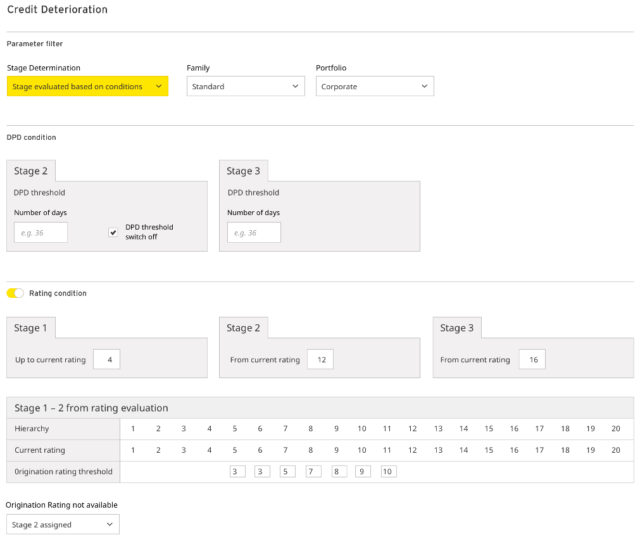
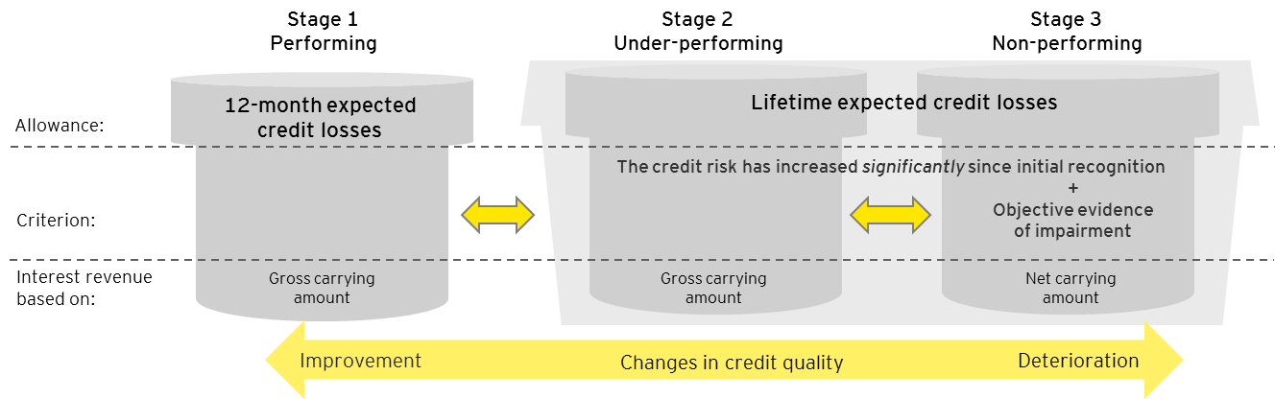
Staging
LIC Solution® provides following options for determination of significant increase in credit risk compared to origination (Stage 2):
DPD threshold
Rating deterioration
Lifetime or 12 month PD deterioration
Flags defined by the Institution
Alternatively, stages provided by the Institution and loaded as an input
When determining assets in Stage 3, LIC Solution® provides following options:
DPD threshold
Rating threshold
Flags defined by the Institution
Alternatively, stages provided by the Institution and loaded as an input
These rules can be configured and combined in the user interface separately for each portfolio.

Slide 10
Staging UI – DPD and Ratings

Slide 11
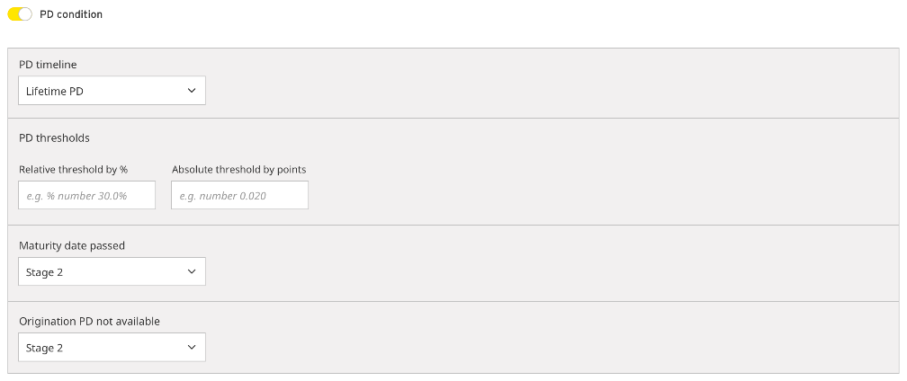
Staging UI – PD parameter

Slide 12
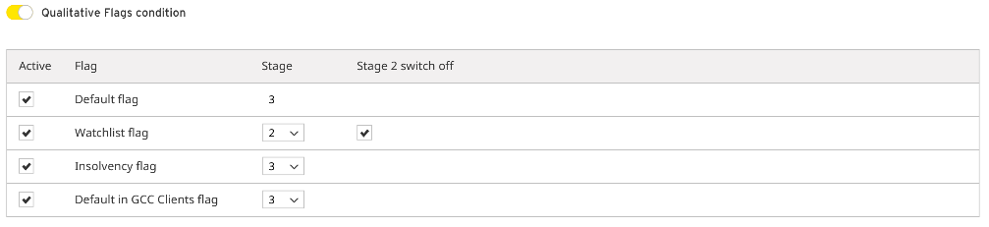
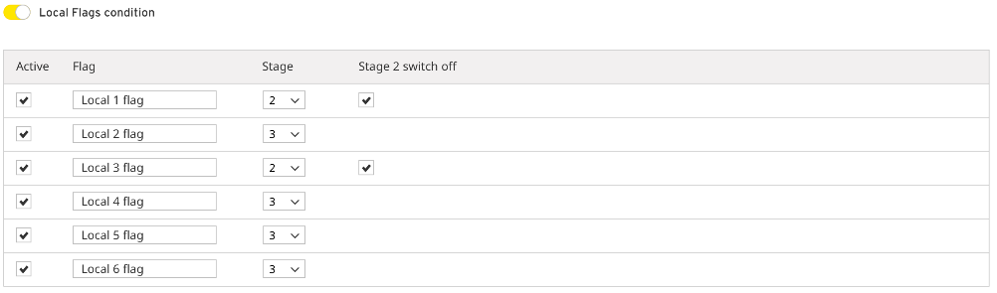
Staging UI – Risk flags

Slide 13
Overview of the applied methods
Applied method for Expected credit loss (ECL) calculation depends on the assessment method and IFRS 9 stage. Additionally exceptions are defined for special classes of assets.
Significant increase in credit risk
Impairment
Stage
Stage
Stage
1
2
3
Individual approach
Evaluation of a range of possible outcomes based on possible scenarios for
future cash flows (discounted by EIR) and their probability
Collective approach
12-month ECL*
Lifetime ECL based on EAD, PD and LGD
Lifetime ECL based on Exposure and LGD
Exceptions
Renewable Credit
Facilities (collective)
12-month ECL regardless
of contractual maturity
Lifetime ECL based on EAD, PD and LGD
Lifetime ECL based on Exposure and LGD
Simplified approach
ECL calculated based on Exposure and the Loss Rate
Purchased or Originated Credit Impaired (POCI)
Either individual approach is applied or future cash flows are generated based on the portfolio recovery curve. Future cash flows are discounted by Credit Adjusted EIR
*For assets with contractual maturity bellow 12 months, contractual maturity ECL can be used.

Slide 14
Segmentation
The segmentation process under IFRS 9 aims to classify the financial instruments based on:
Portfolio – with respect to business line, product type, currency, term to maturity
Stage – Type of ECL measurement base (12-month or lifetime) and way of interest revenue recognition
Assessment method – Assessment on individual or collective basis, with exceptions for Purchased or Originated Credit Impaired (POCI) assets, Renewable Credit Facilities and Loss Rate approach
Assessment method (Individual / Collective)
Categorization of assets into product portfolios is provided by the Institution. Staging is either provided by the Institution or is based on rules defined via user interface. Automated choice of the assessment method can be configured in LIC Solution® through user interface based on:
Manual adjustment of the list of individually assessed clients (adding and removing clients) is possible after automatic selection.
Exposure (materiality limit)
Stage
Portfolio
Individual assessment (selected automatically)
ALL LOANS
Automatic selection for individual assessment
ALL LOANS
Manual selection (subjective decision of authorized person)
ALL LOANS
Portfolio 1
Portfolio 2
Collective assessment
Collective assessment
Individual assessment (selected manually)
Portfolio 3

Slide 15
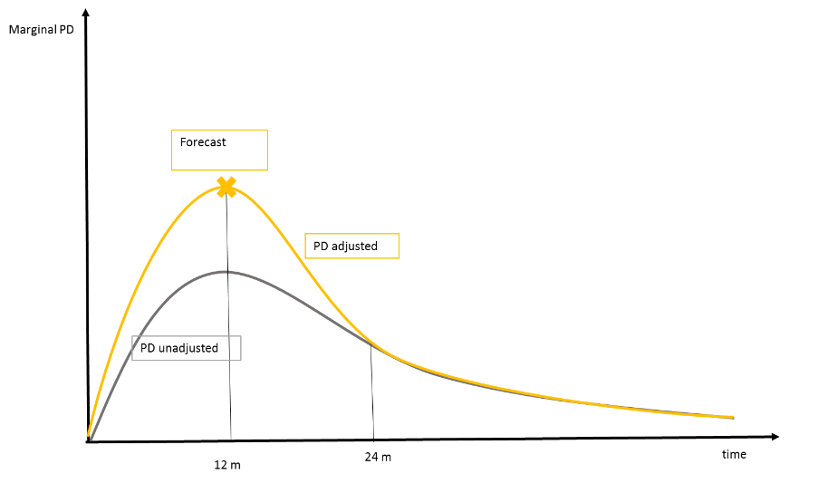
PD parameter
Two options for PDs are provided by LIC Solution:
PD lifetime curves in input data as either:
Applicable PD after forward-looking adjustment
PD Through-the-cycle (TTC)
PD Point-in-time (PIT)
PD estimation from transition matrices
PDs are estimated in LIC Solution® based on Markov Chain process, which requires information regarding transitions among credit states (DPD buckets / rating classes).
Transition probabilities are estimated using average of monthly transitions over a chosen time period
12-month PDs are then calculated as 12th power of the monthly migration matrix
Lifetime PDs are estimated using n-th power of the monthly migration matrix, where n stands for contractual maturity
State |  | End
 |  | 0 | 30 | 60 | 90 | Default
Initial | 0 | 92.7% | 7.3% | 0.0% | 0.0% | 0.0%
 | 30 | 16.7% | 54.2% | 29.2% | 0.0% | 0.0%
 | 60 | 0.0% | 35.0% | 52.4% | 12.6% | 0.0%
 | 90 | 0.0% | 23.8% | 16.7% | 47.6% | 11.9%
 | Default | 92.7% | 7.3% | 0.0% | 0.0% | 0.0%
Depending on the form of input, the PD values are adjusted in LIC Solution® to reflect forward looking elements and PIT approach using parameters entered in the user interface on portfolio level:
forecasted multiple (k) for 12-month marginal PD
number of months after which the forecasted marginal PD curve equals to the unadjusted curve
Multiple k can be alternatively estimated in LIC Solution® on asset level using Bayesian formula.

Slide 16
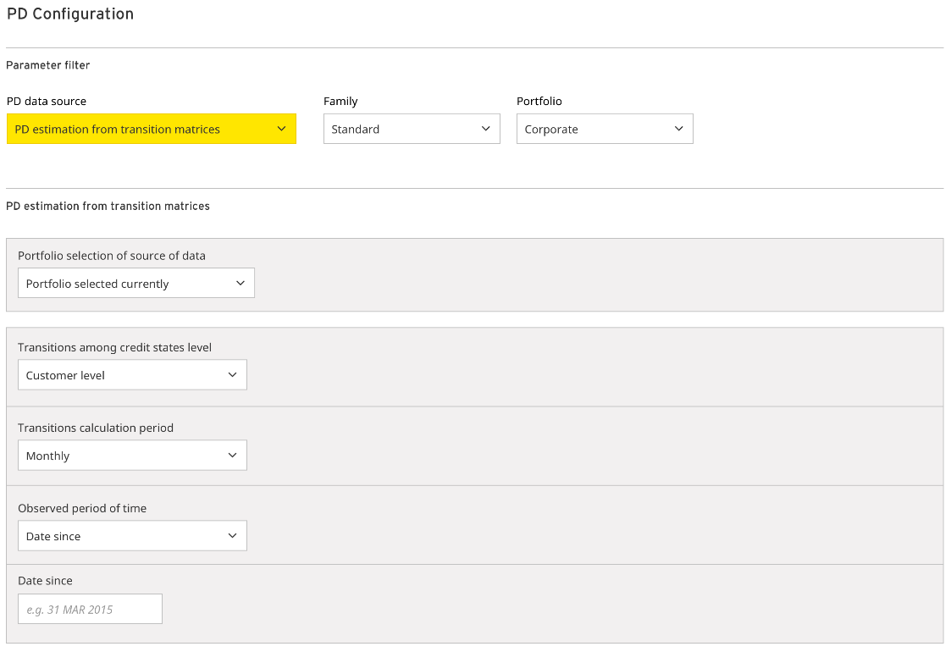
PD parameter configuration

Slide 17
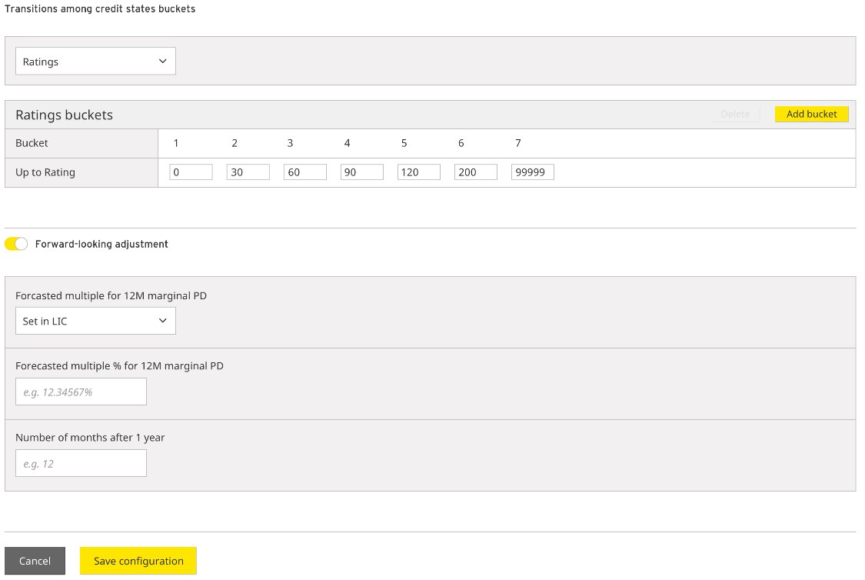
PD parameter configuration

Slide 18
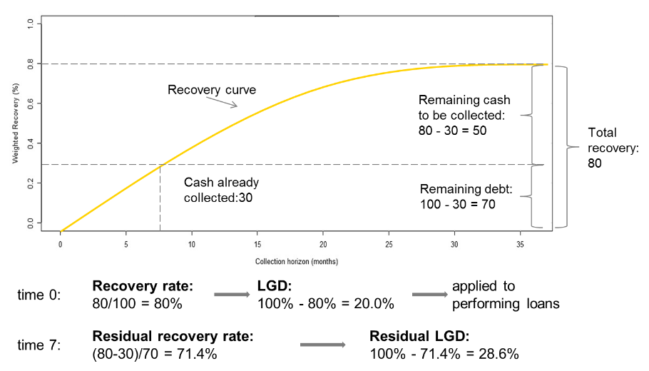
LGD parameter
Multiple options for LGD parameter are available in LIC Solution® including:
LGD lifetime curves in input data
LGD lifetime curve estimation reflecting LTV change
One-off input of portfolio level residual LGD curve
LGD estimation based on collateral recovery
Stage 1 and Stage 2 assets
Two types of LGDs can be loaded on exposure level or manually set on portfolio level:
LGD
Unsecured LGD – collateral data are imported to LIC Solution® with the possibility for manual re-allocation of collaterals
Stage 3 assets
LIC Solution® provides several options to derive residual LGD:
loaded from input data on asset level
calculated based on collaterals
based on the number of months after default and portfolio recovery curve provided by the Institution
Forward-looking adjustment is reflected in LGDs through three different haircuts that can be applied per collateral type:
Haircut applicable for next 12 months
Haircut applicable for months 13-24
Haircut applicable for months 25+
Alternatively to providing collateral information, LTV (loan-to-value) parameter provided by the Institution on asset level can be used. More advanced approach reflecting lifetime development of LGD is also available.

Slide 19
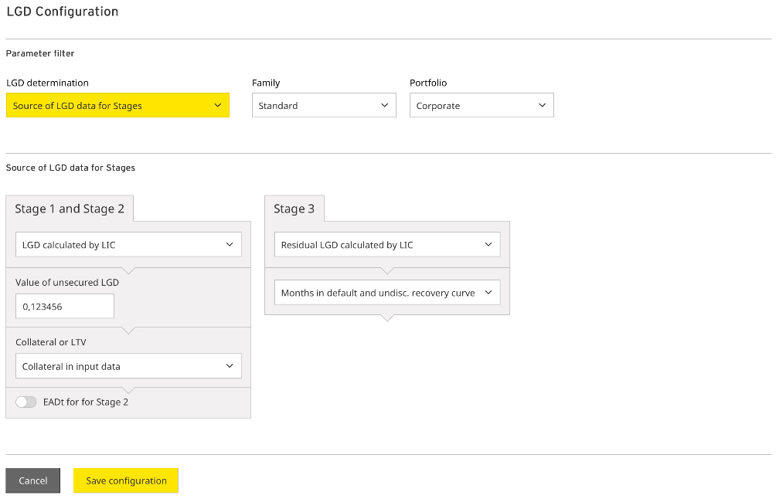
LGD parameter configuration

Slide 20

EAD parameter
For EAD parameter LIC Solution® provides two options:
EAD curve (monthly EAD_{t}) provided by the Institution in input data
EAD curve estimated in LIC Solution
EAD curve is in LIC Solution® estimated using:
$${EAD}_{t}={Onbalance exposure}_{t}+{Offbalance exposure}_{t}×{CCF}_{t}$$
Contractual on-balance cash-flow curve can be provided in input data or, estimated based on payment type:
Constant exposure development
Annuity approach
Linear approach
Deferral of installments
Expected maturity estimate based on:
Contractual maturity
Pre-payment factor - multiplied with contractual maturity, it provides an estimate for expected maturity after which no on-balance sheet exposure is expected
Credit conversion factor (CCF) values are provided by the Institution as an input on asset level, or manually entered through user interface on portfolio level.

Slide 21
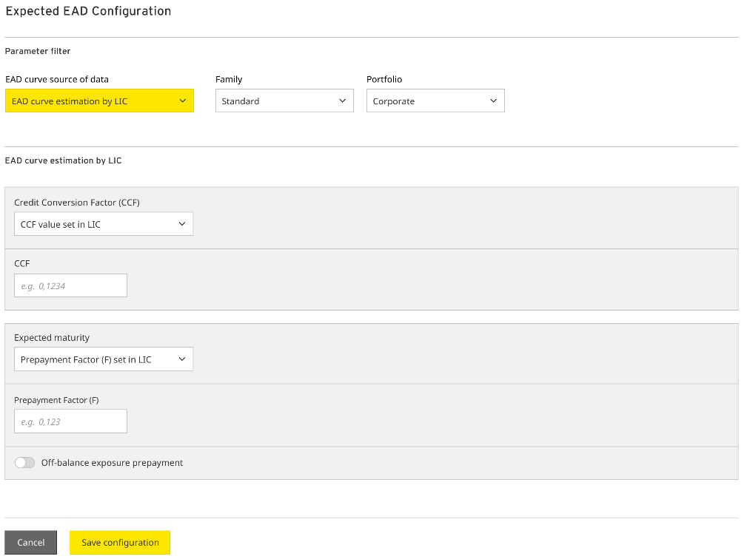
EAD parameter configuration

Slide 22
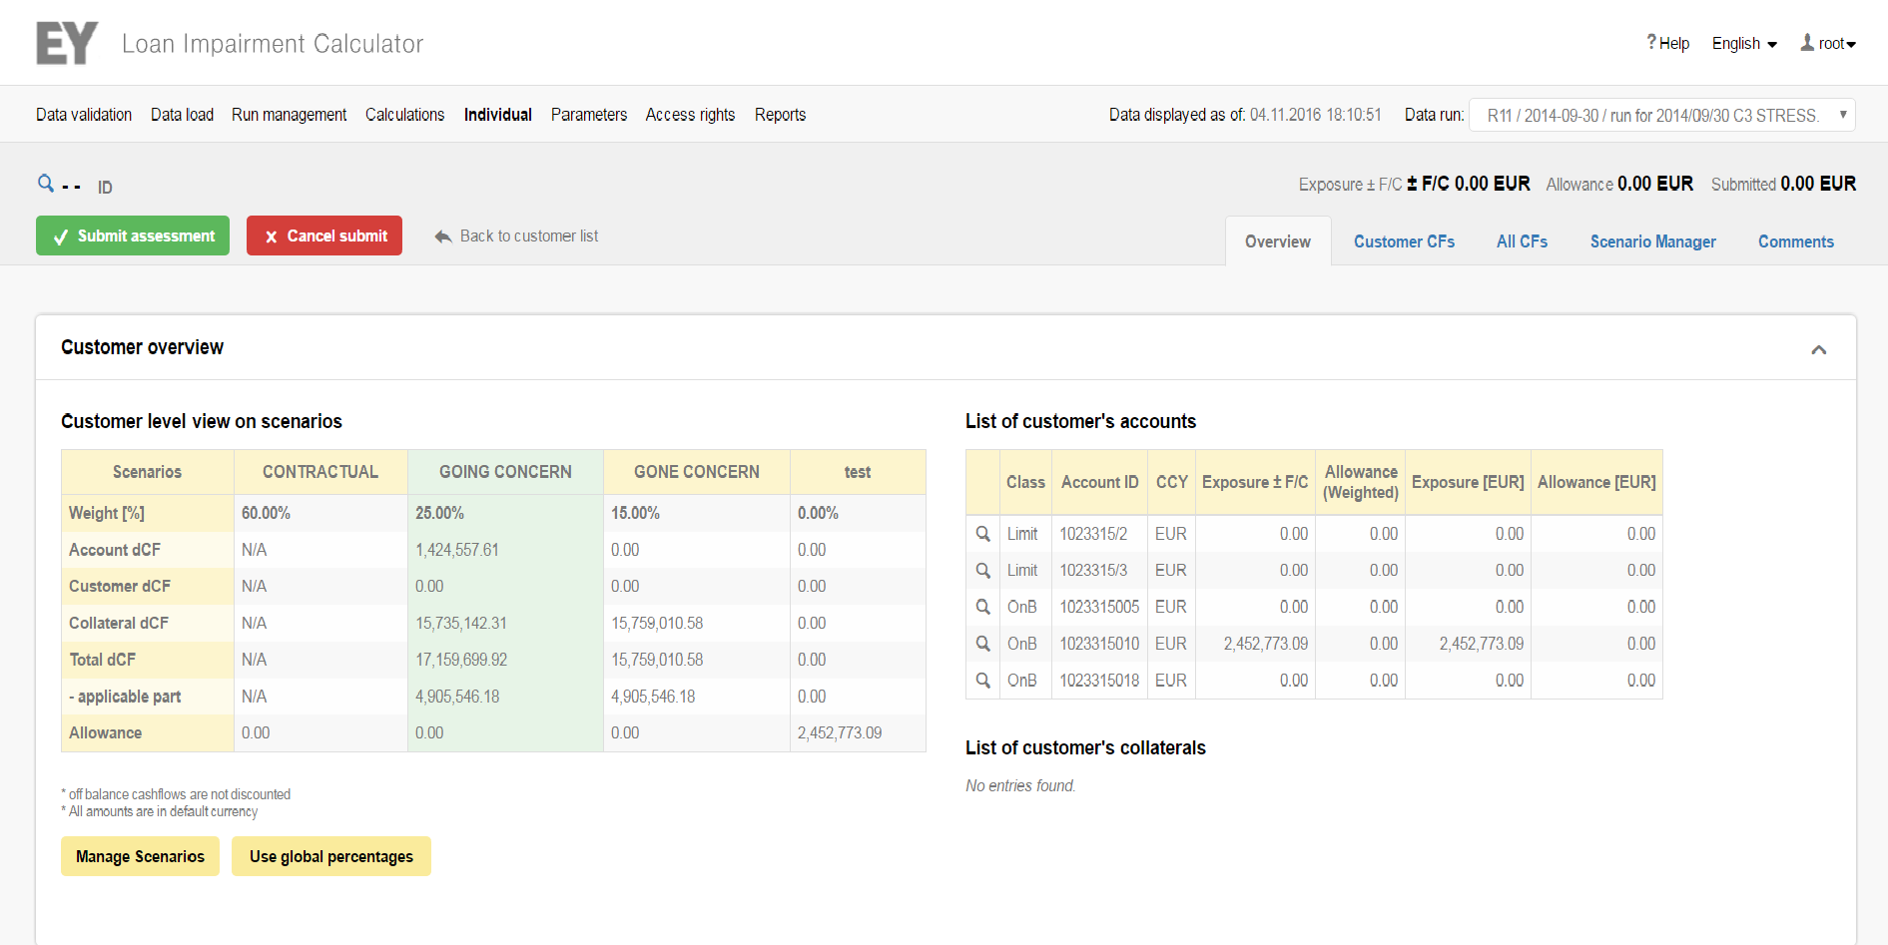
Individual assessment
Based on projecting future cash flows from on-going business and collateral realization
Support for collateral allocation adjustment
Traffic lights indicate need of reassessment based on the difference between forecasted and actual cash flows and elapsed time validity of assessment
Four-eyes principle (input, approval) and full user action logging applied
Allows for:
1
2
CF modelling
Entering expected cash-flows on customer/account/collateral level
Manual input of dates and amounts supported by block functions
Scenario setting
Flexible number of cash-flow scenarios
Support for the management of probability weights of scenarios

Slide 23
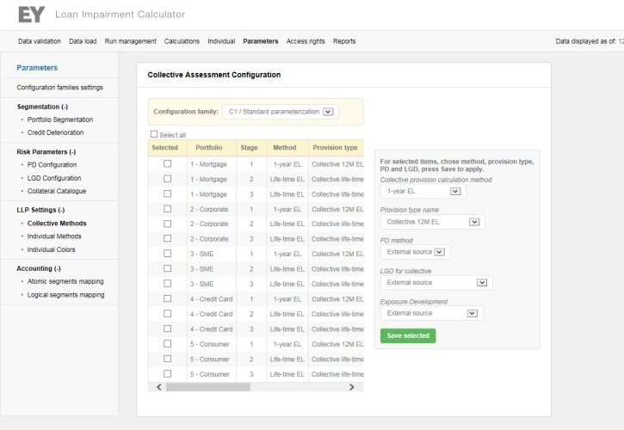
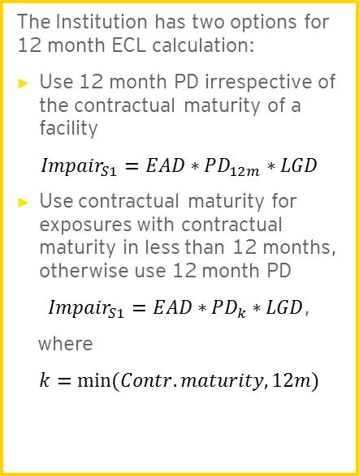
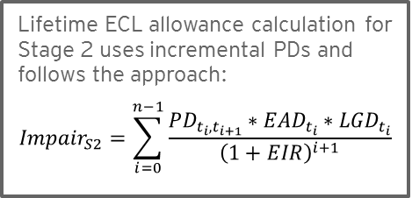
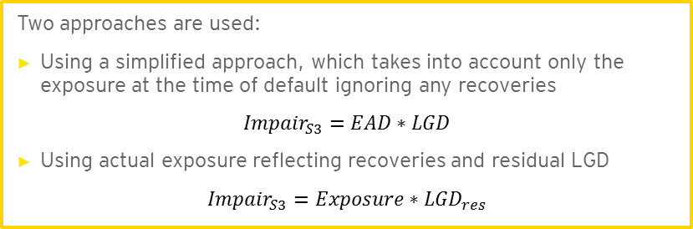
Collective assessment
12-month ECLs
Lifetime ECLs
100% allowance
1
2
3
t
Origination
Significant
increase in credit risk
Impairment
Recovery horizon
Stage
Stage
1
2
The Institution has two options for 12 month ECL calculation:
Use 12 month PD irrespective of the contractual maturity of a facility
$${Impair}_{S1}=EAD∗{PD}_{12m}∗LGD$$
Use contractual maturity for exposures with contractual maturity in less than 12 months, otherwise use 12 month PD
${Impair}_{S1}=EAD∗{PD}_{k}∗LGD$,
where
$$k=min⁡(Contr. maturity, 12m)$$
Lifetime ECL allowance calculation for Stage 2 uses incremental PDs and follows the approach:
$${Impair}_{S2}=\sum_{i=0}^{n−1}{\frac{{PD}_{t_{i}{,t}_{i+1}}∗{EAD}_{t_{i}}∗{LGD}_{t_{i}}}{{\left(1+EIR\right)}^{i+1}}}$$
Stage
3
Two approaches are used:
Using a simplified approach, which takes into account only the exposure at the time of default ignoring any recoveries
$${Impair}_{S3}=EAD∗LGD$$
Using actual exposure reflecting recoveries and residual LGD
$${Impair}_{S3}=Exposure∗{LGD}_{res}$$

Slide 24
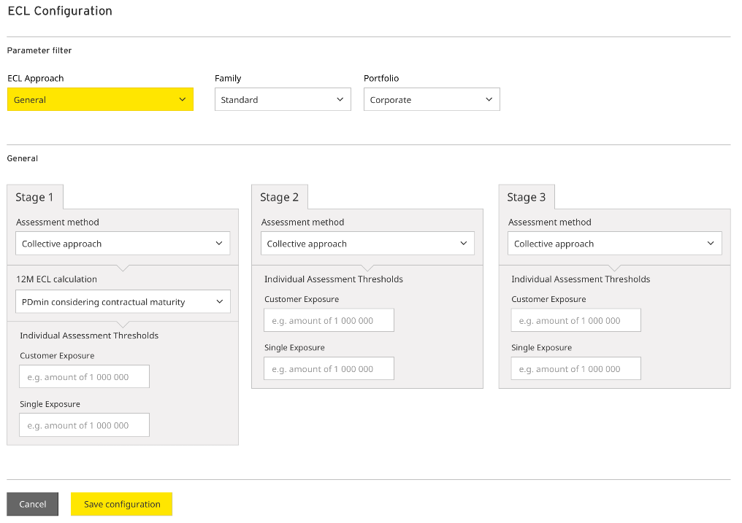
Collective Assessment UI – ECL Configuration

Slide 25
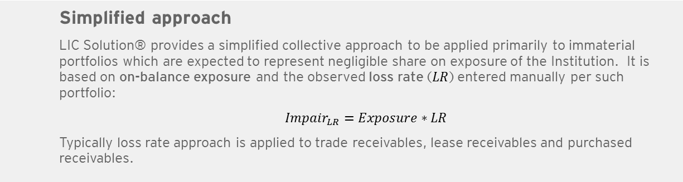
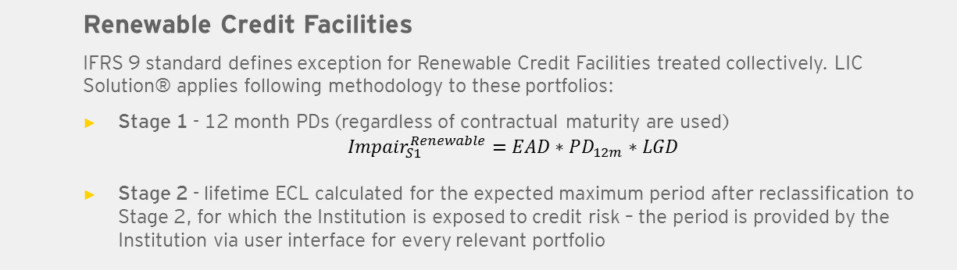
Applied methodology for special classes of assets
1
Renewable Credit Facilities
IFRS 9 standard defines exception for Renewable Credit Facilities treated collectively. LIC Solution® applies following methodology to these portfolios:
Stage 1 - 12 month PDs (regardless of contractual maturity are used)
$${Impair}_{S1}^{Renewable}=EAD∗{PD}_{12m}∗LGD$$
Stage 2 - lifetime ECL calculated for the expected maximum period after reclassification to Stage 2, for which the Institution is exposed to credit risk – the period is provided by the Institution via user interface for every relevant portfolio
2
Simplified approach
LIC Solution® provides a simplified collective approach to be applied primarily to immaterial portfolios which are expected to represent negligible share on exposure of the Institution. It is based on on-balance exposure and the observed loss rate ($LR$) entered manually per such portfolio:
$${Impair}_{LR}=Exposure∗LR$$
Typically loss rate approach is applied to trade receivables, lease receivables and purchased receivables.

Slide 26
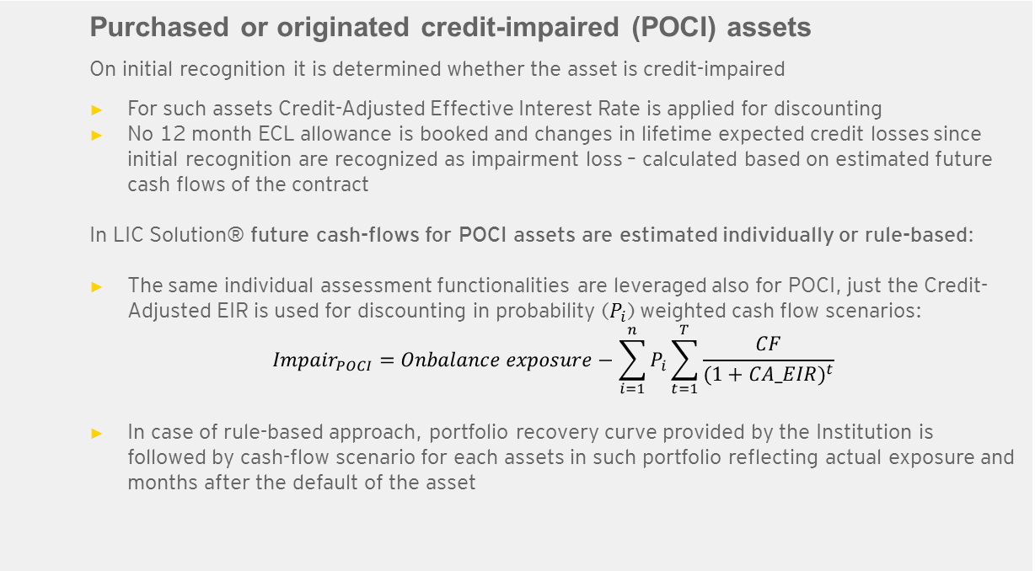
Applied methodology for special classes of assets (cont.)
3
Purchased or originated credit-impaired (POCI) assets
On initial recognition it is determined whether the asset is credit-impaired
For such assets Credit-Adjusted Effective Interest Rate is applied for discounting
No 12 month ECL allowance is booked and changes in lifetime expected credit losses since initial recognition are recognized as impairment loss – calculated based on estimated future cash flows of the contract
In LIC Solution® future cash-flows for POCI assets are estimated individually or rule-based:
The same individual assessment functionalities are leveraged also for POCI, just the Credit-Adjusted EIR is used for discounting in probability ($P_{i}$) weighted cash flow scenarios:
$${Impair}_{POCI}=Onbalance exposure−\sum_{i=1}^{n}{P_{i}}\sum_{t=1}^{T}{\frac{CF}{{(1+CA_EIR)}^{t}}}$$
In case of rule-based approach, portfolio recovery curve provided by the Institution is followed by cash-flow scenario for each assets in such portfolio reflecting actual exposure and months after the default of the asset

Slide 27
Data output and reporting
After the calculation process, LIC Solution® transforms the results into a standardized pre-defined output data format. Interfacing methods to extract the output from the solution are provided and support parametrization (e.g. date of output data, version of output data). Readiness of the output data in LIC Solution® is registered automatically. It is the responsibility of the Institution to call the interfacing methods to extract output data.
Output data generation
Reporting
The output data contain following information on asset level:
Date of calculation
Exposure
PD
LGD
CCF
Stage 1/2/3
Portfolio
Individual / Collective Assessment / POCI
Impairment including its split
Etc.
Following key reports are prepared by LIC Solution® from the output data:
Split of exposures and impairments by Portfolios and Stages
Changes in exposure and impairment split compared to the previous months
Changes in exposure and impairment split compared to the start of the financial year

Slide 28
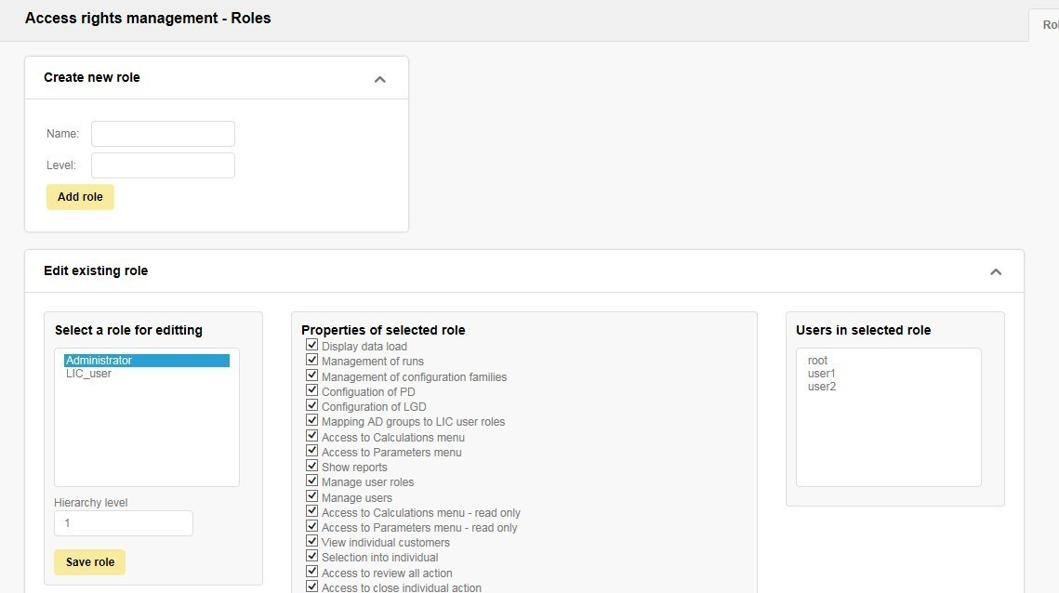
User management and audit track
User management
LIC Solution® supports Active Directory authentication of users. It enables seamless single-sign-on user experience.
Application roles can be managed and defined directly through user interface. Application roles are granted to Active Directory Groups using the same user interface.
Users’ membership in Active Directory Groups can be managed centrally via Institution’s Identity and Access Management tools.
Permissions for particular role are set by selecting them from the list of atomic permissions (e.g. view permission for a page, data modification permission, etc.).
Audit track
General auditing functionality – tracking all user and administrator actions in the solution, logging calculation steps, entries/exits
Audit reports – visualize/look up the data

Slide 29
Variability in calculation run configuration
LIC Solution® has been specially designed to provide flexible configuration of calculation runs. Examples of extended variability features in calculation phases include:
Segmentation and Staging
IFRS 9 staging criteria configuration
Individual Assessment
Configuration of automatic selection criteria for Individual Assessment
Definition of work flow (roles & rules) in Individual Assessment, e.g. Inputter, Approver, etc.
Impairment
Collective assessment method selection on portfolio level
Risk parameters definition, e.g. PD, LGD, EAD (internal or external model, or edited values)
Special classes of assets
Special approaches to impairment calculation for Purchased or Originated Credit-Impaired (POCI) assets and Renewable Credit Facilities, simplified Loss Rate approach used for receivables
Sensitivity Analysis
Performing multiple calculation runs with different parameter configuration supports sensitivity analysis required by IFRS 9

Slide 30
Variability in Individual Assessment
Future cash flows in the Individual Assessment can be modeled very flexibly, taking the advantage of additional layers of variability for each such Individual Assessment exercise:
Scenarios
Definition of multiple (N) scenarios for each relevant recovery strategy
Assignment of probability weight to each such scenario
As an illustrative example, we can consider N=2 scenarios e.g.:
1
GONE (85%) | GOING (15%)
Different objects for which cash flows can be modeled
Three possible main object types for future cash flow analytical modeling - on the level of account, collateral and entire client
2
ENTIRE CLIENT | ACCOUNT | COLLATERAL

Slide 31
Constant development of LIC Solution®
Our dedicated team is developing the LIC Solution® continuously since 2007. We are proactively tracking market trends and regulatory requirement developments in order to be ready to introduce important up-to-date LIC Solution® version to our client base.
Support with the initial live runs under IFRS 9
Improving LIC Solution® performance through optimization of calculations
IFRS 9 quantitative disclosure package
Alternative approaches to impairment calculation for off-balance exposures
Rule-based approach to POCI impairment calculation
New modern version of web application GUI (front-end graphical user interface)
IFRS 9 staging
Advanced sensitivity analysis for IFRS 9
2018
2017
2016

